Slide 1


Introduction - Blynk - Firebase
NodeMCU
Eueung Mulyana https://eueung.github.io/012017/nodemcu
CodeLabs | Attribution-ShareAlike CC BY-SA
1 / 43

Slide 2
NodeMCU DEVKIT V1.0
Firebase Version: 3.6.4 | Blynk Library v0.4.4 Arduino IDE 1.8.1

Slide 3
Outline
Introduction
Using Arduino IDE
NodeMCU + Blynk
NodeMCU + Firebase

Slide 4
Introduction

Slide 5
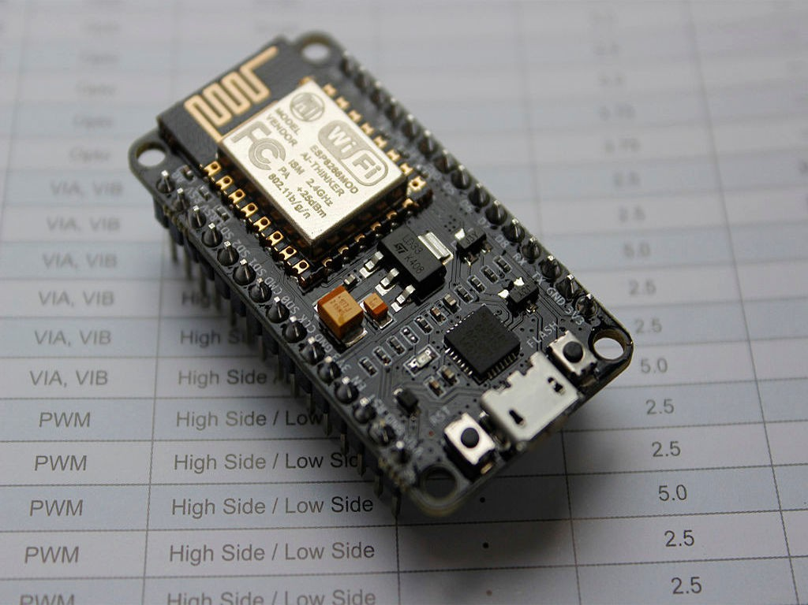

Slide 6
NodeMCU
NodeMCU is a LUA based interactive firmware for Expressif ESP8622 Wi-Fi SoC, as well as an open source hardware board that includes a (CP2102/CH340/..) TTL to USBchip for programming and debugging, is breadboard-friendly, and can simply be powered via its micro USBport.
Ref: cnx-software

Slide 7
NodeMCU
Firmware + DevKits
NodeMCU is an eLua based firmware for the ESP8266 WiFi SOC from Espressif. The firmware is based on the Espressif NON-OS SDK and uses a file system based on spi¦s.
The NodeMCU firmware is a companion project to the popular NodeMCU DevKits, ready-made open-source development boards with ESP8266-12E chips.
The NodeMCU programming model is similar to that of Node.js, only in Lua. It is asynchronous and event-driven. Many functions, therefore, have parameters for callback functions.
Ref: NodeMCU Documentation

Slide 8
1. ESP-12E WiFi Module (16 GPIOs)
4 MB (32 Mb) Flash Storage
128 KB Memory
Micro USB(5V Power, Program, Debug)
2x15-Pin Headers (GPIOs, SPI, UART, ADC, Power)
Notes: Pins still at 3.3V!
NodeMCU
DevKit v1.0

Slide 9
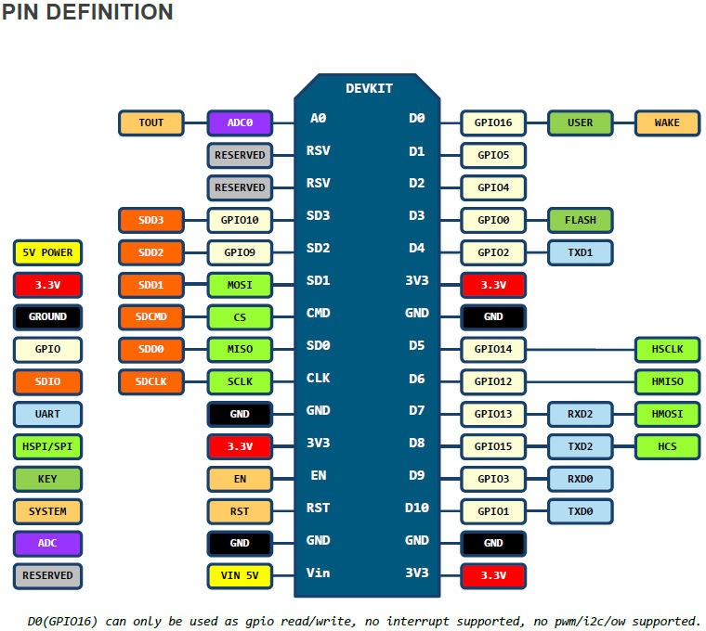
V1.0 Pin Map

Slide 10
Arduino IDE

Slide 11
Using Arduino
IDE
Install Arduino IDE
Start Arduino and open Preferences window
Enter board URL into Additional BM URLs
Open Boards Manager and install esp8266
Select your NodeMCU board
Develop Sketches and Flash NodeMCU with Arduino IDE
(C-Style)!
Starting with 1.6.4, Arduino allows installation of third-party platform packages using Boards Manager.
http://arduino.esp8266.com/stable/package_esp8266com_index.json

Slide 12
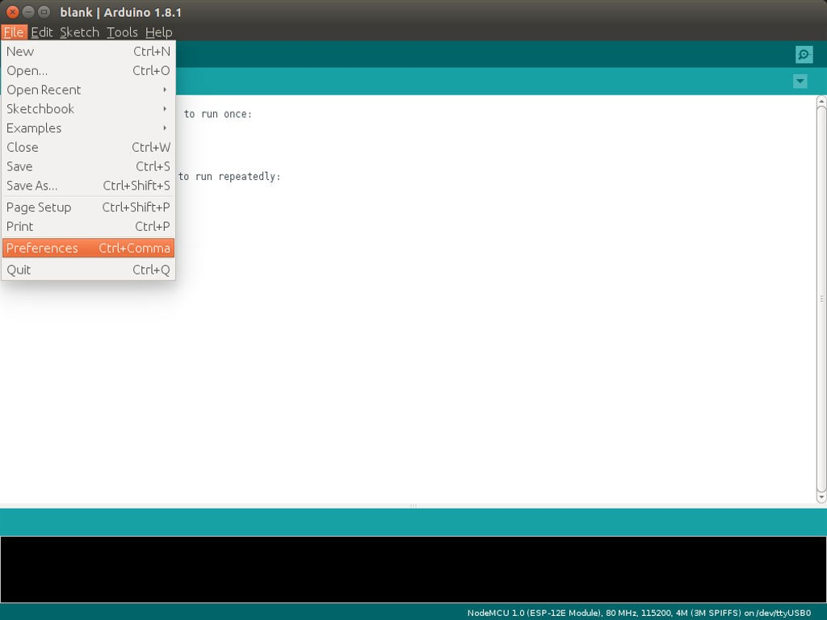
#2 | File | Preferences

Slide 13
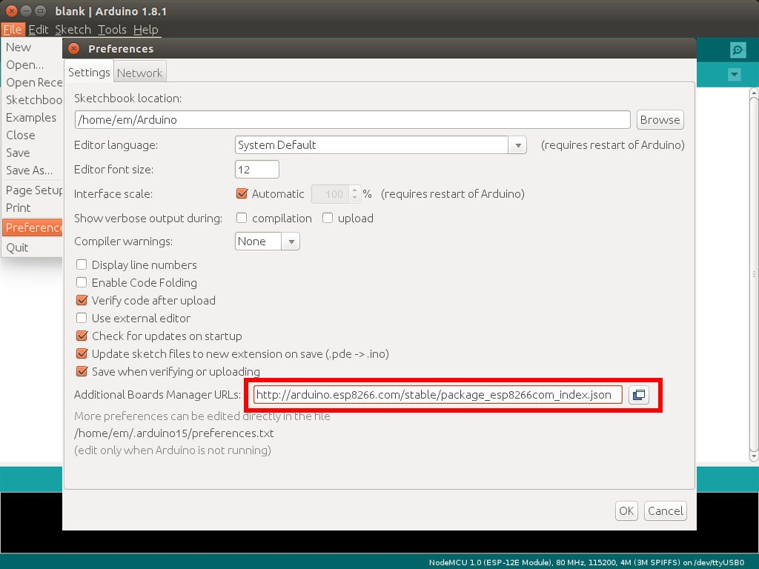
#3 | File | Preferences | BM URLs

Slide 14
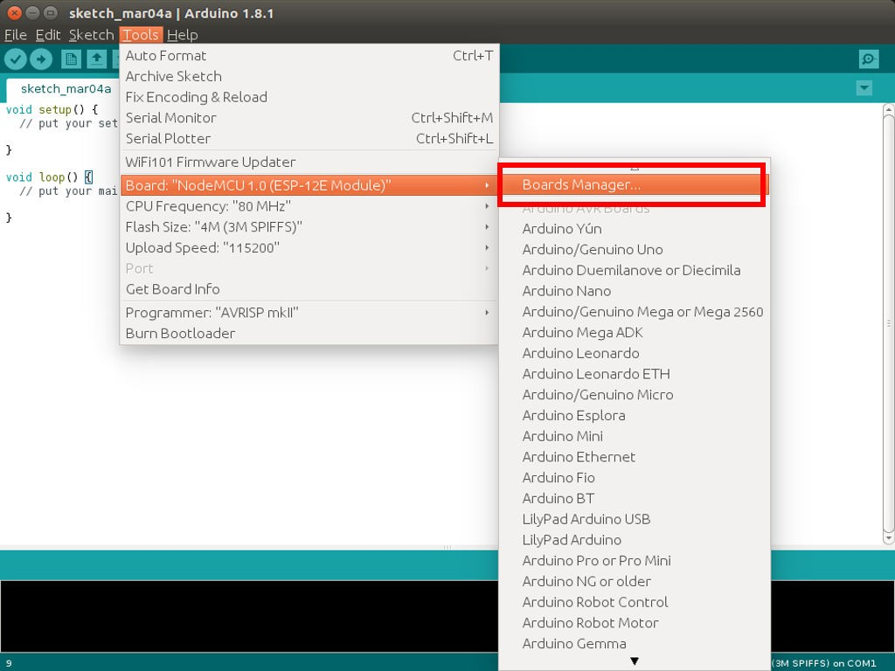
#4 | Tools | Board | Boards Manager

Slide 15
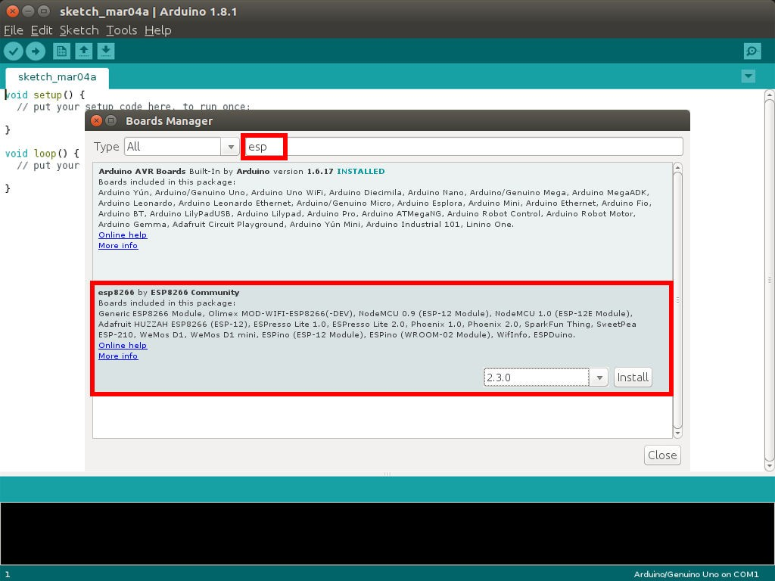
#4 | esp8266

Slide 16
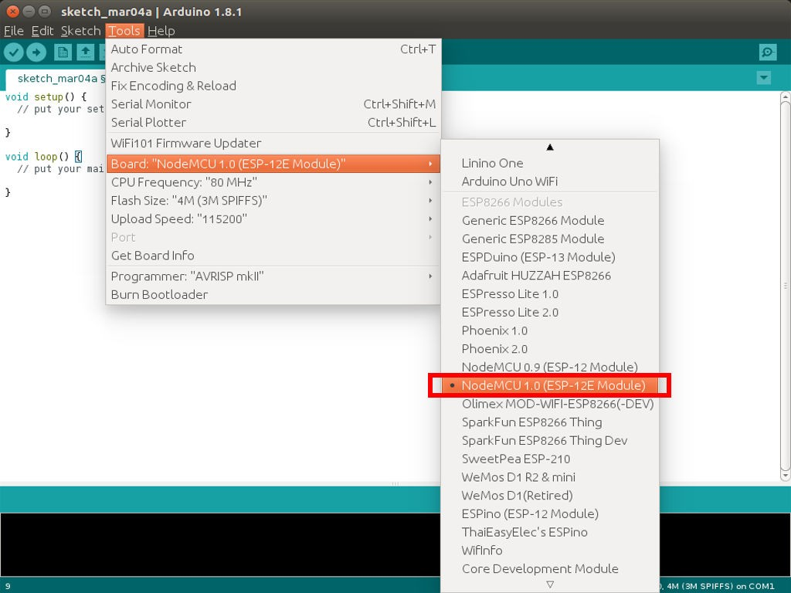
#5 | Tools | Board | NodeMCU 1.0

Slide 17
Blynk

Slide 18
NodeMCU &
Blynk
Configure Arduino IDE for NodeMCU (as before)
Install Blynk Library
Prepare/Configure Blynk App
Prepare the Board, Create the Sketch & Flash
Play the Project (Blynk App)!
Using Arduino IDE

Slide 19
~/Arduino$ tree
.
|-- blank
| |-- blank.ino
|-- libraries
|-- readme.txt
2 directories, 2 files
#---------------------
#2
Install Blynk Library
~/Arduino$ tree -L 2
.
|-- blank
| |-- blank.ino
|-- libraries
| |-- readme.txt
| |-- Adafruit_NeoPixel
| |-- Blynk
| |-- BlynkESP8266_Lib
| |-- SimpleTimer
| |-- Time
| |-- TinyGSM
|-- tools
|-- BlynkUpdater
|-- BlynkUsbScript
11 directories, 2 files
URL: blynkkk/blynk-library

Slide 20
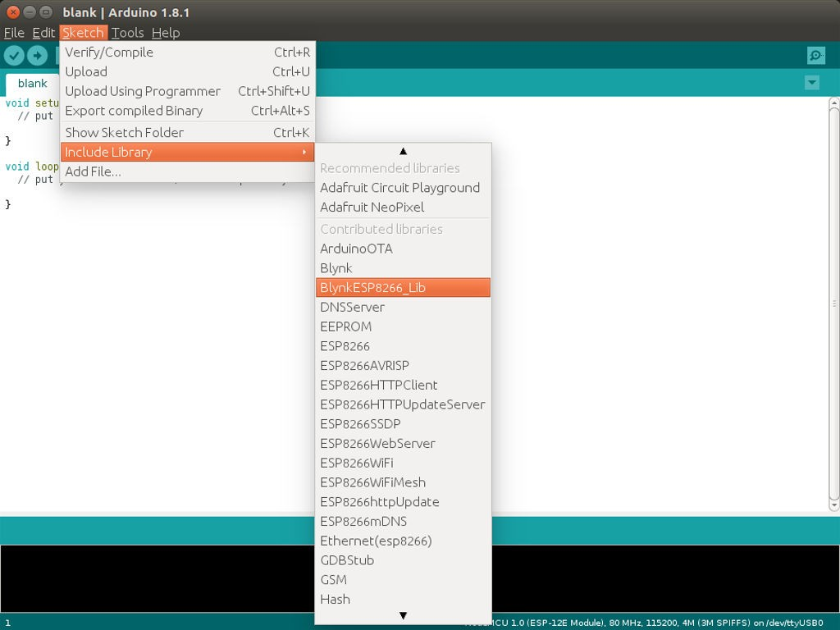
#2 - Check

Slide 21
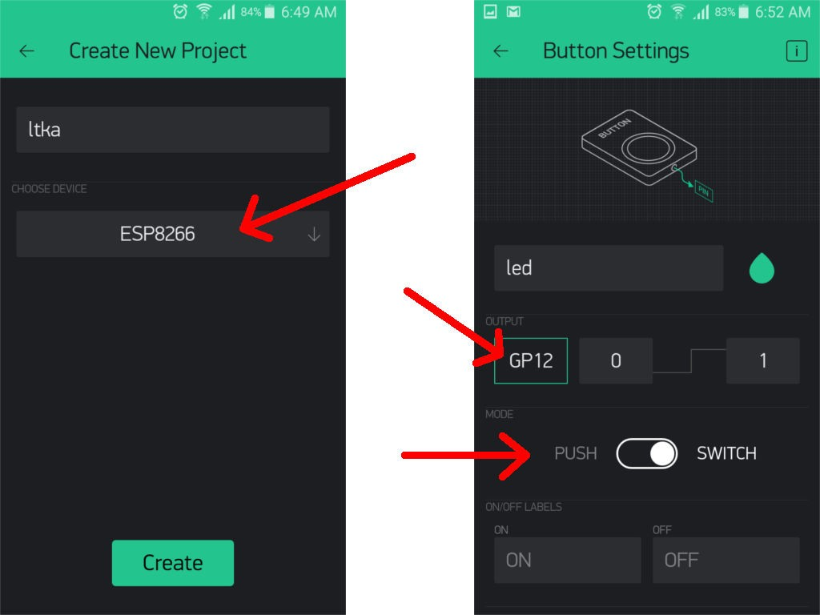
#3 - Configure Blynk App

Slide 22
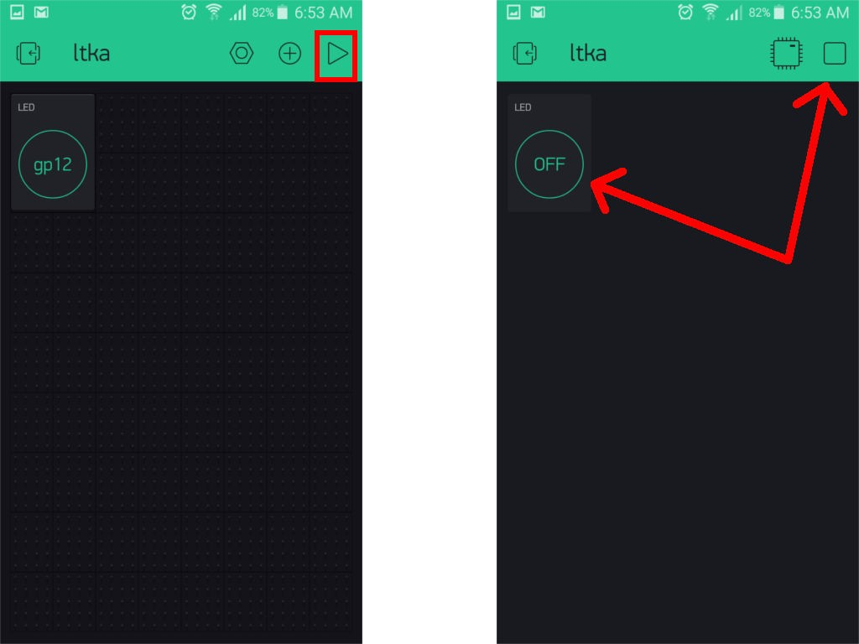
#3 - Configure Blynk App

Slide 23
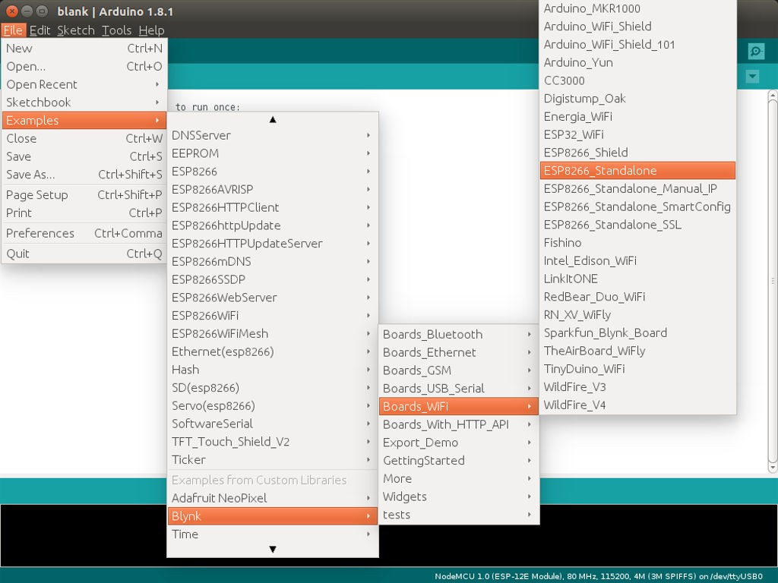
#4 - Sketch

Slide 24
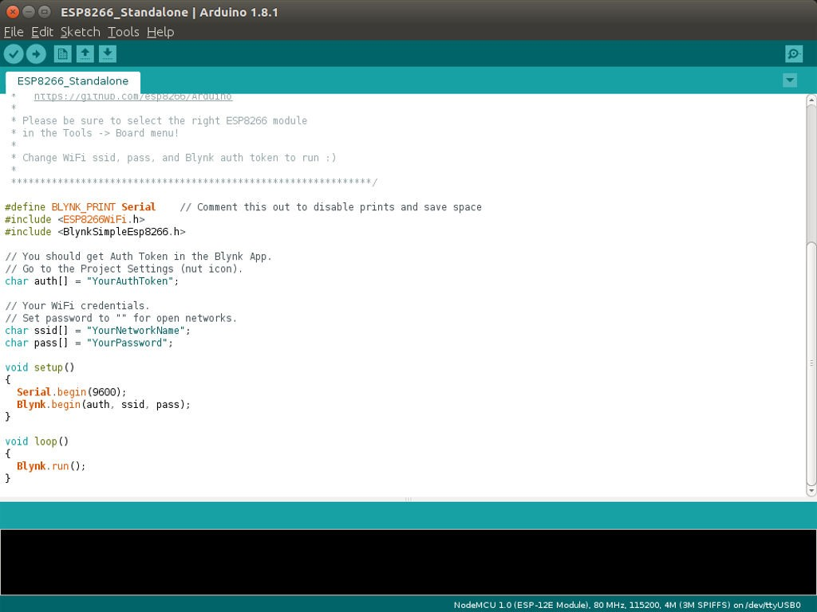
#4 - Sketch - cf. Sketch Builder
24 / 43

Slide 25
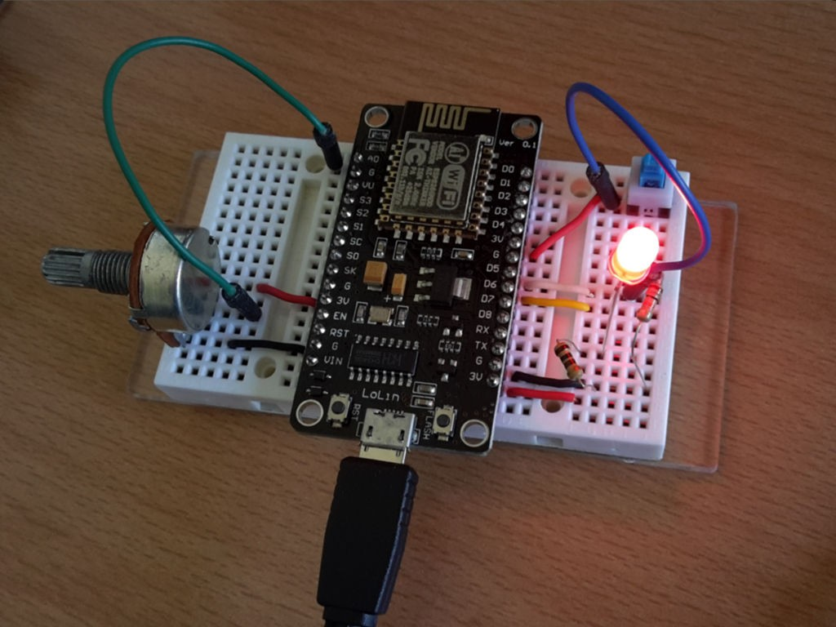
#5 - Play!

Slide 26
Firebase

Slide 27
NodeMCU & Firebase
Using Arduino IDE
Configure Arduino IDE for NodeMCU (as before)
Install FirebaseArduino Library
Create a Firebase Project
Use Example Sketch FirebaseRoom_ESP8266
Prepare the Circuit & Flash
Play!

Slide 28
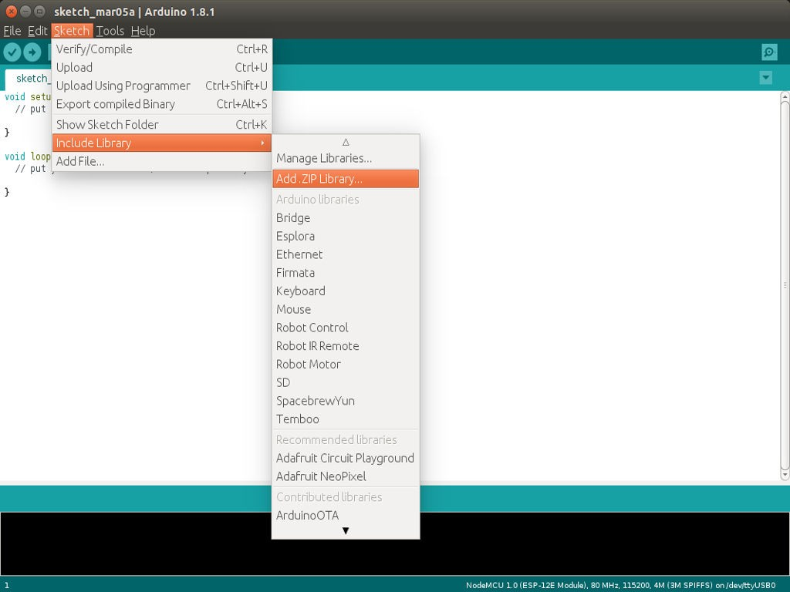
#2 - Install FirebaseArduino

Slide 29
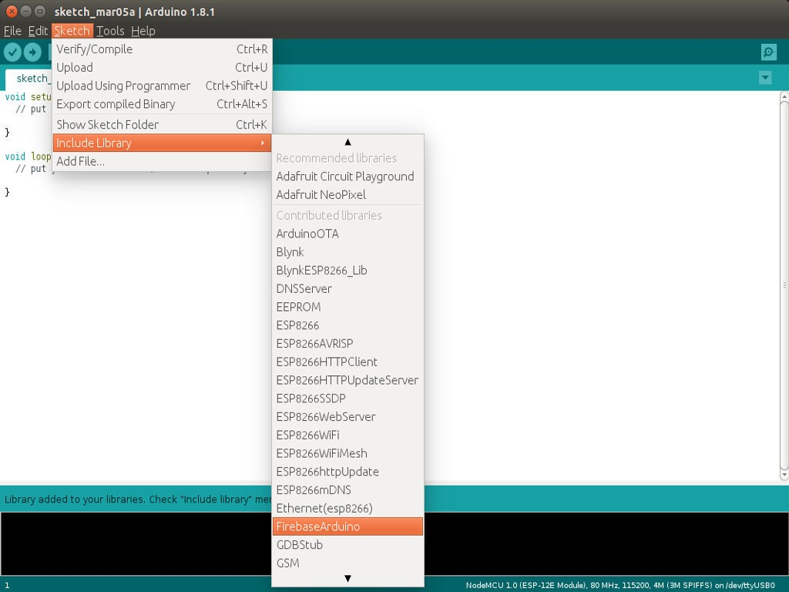
#2 - Check

Slide 30
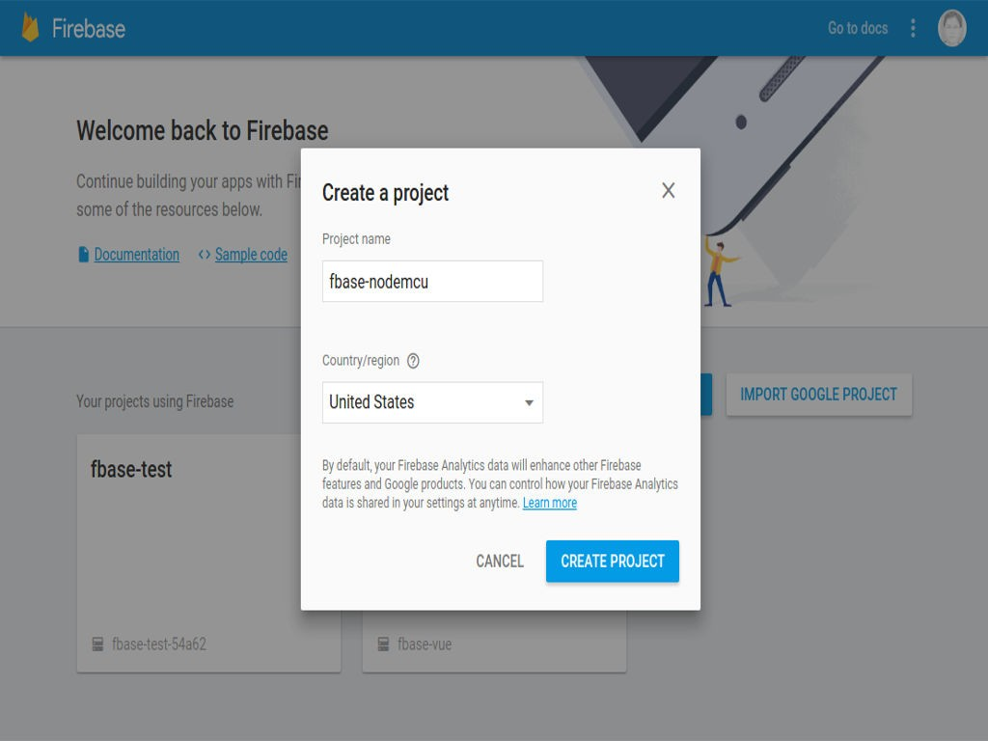
#3 - Create Firebase Project

Slide 31
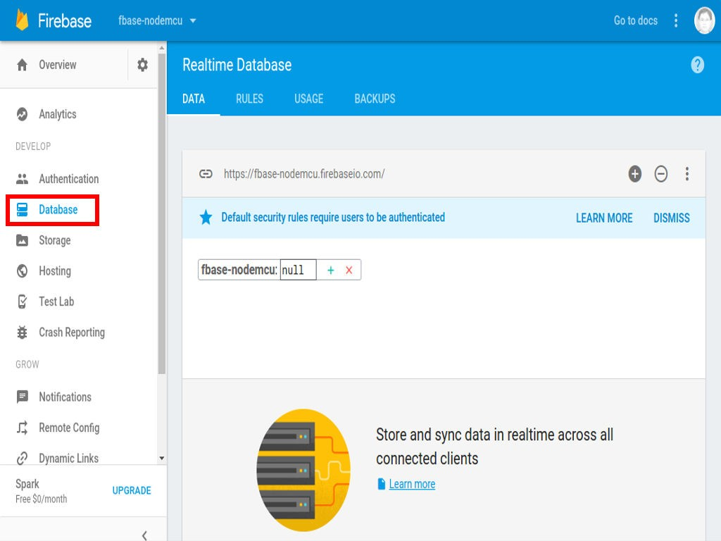
#3 - Create Firebase Project : Host

Slide 32
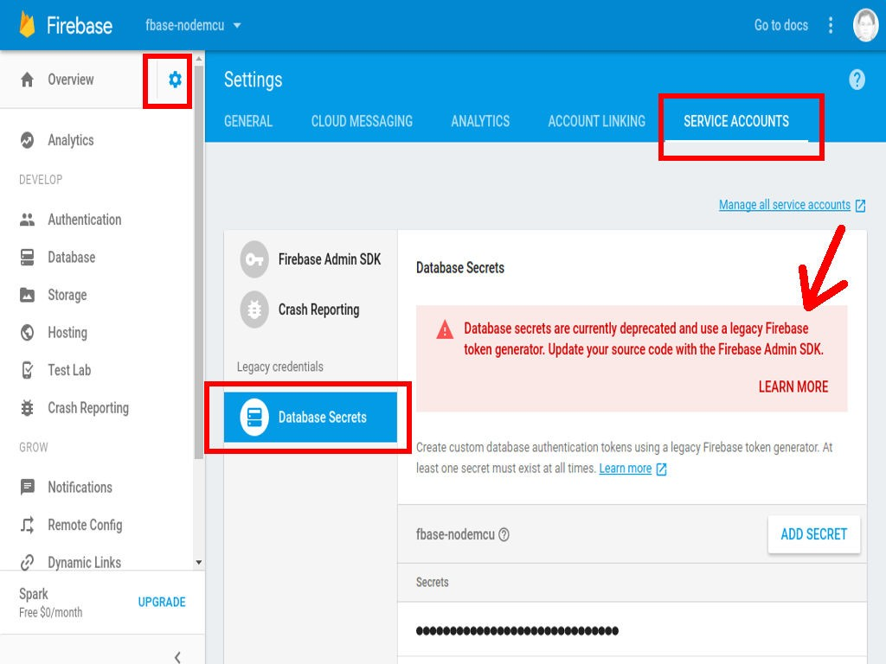
#3 - Create Firebase Project : DB Secret

Slide 33
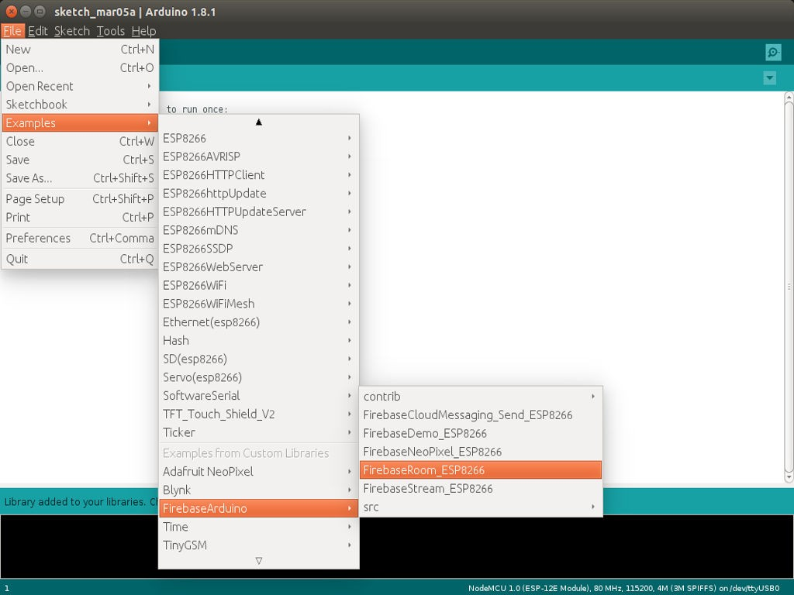
#4 - Example Sketch FirebaseRoom

Slide 34
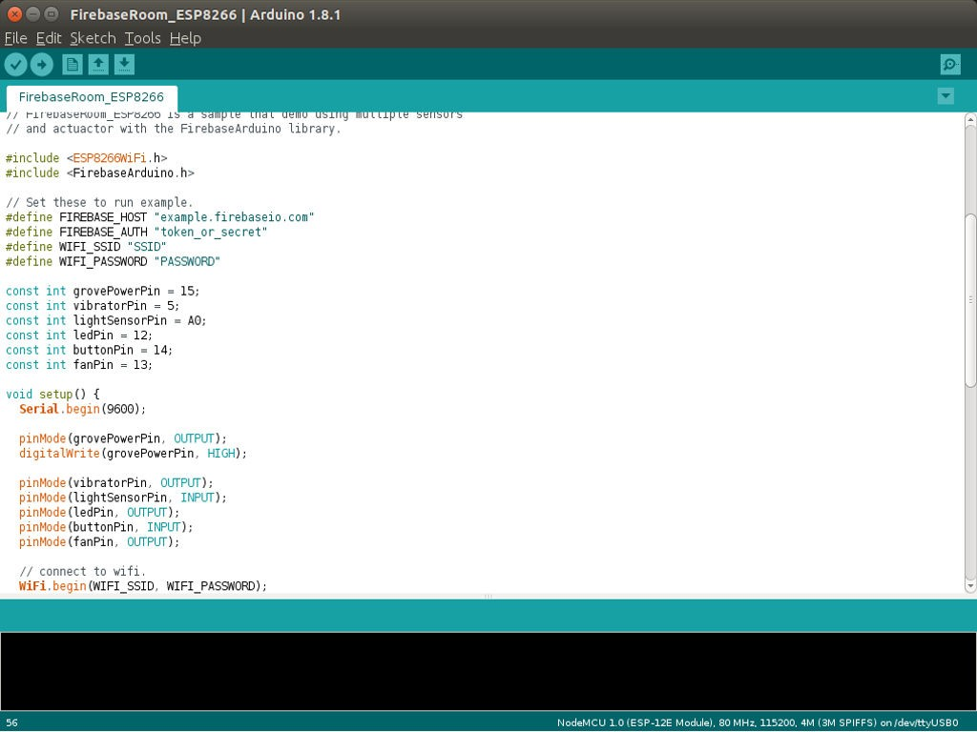
#4 - Example Sketch FirebaseRoom

Slide 35
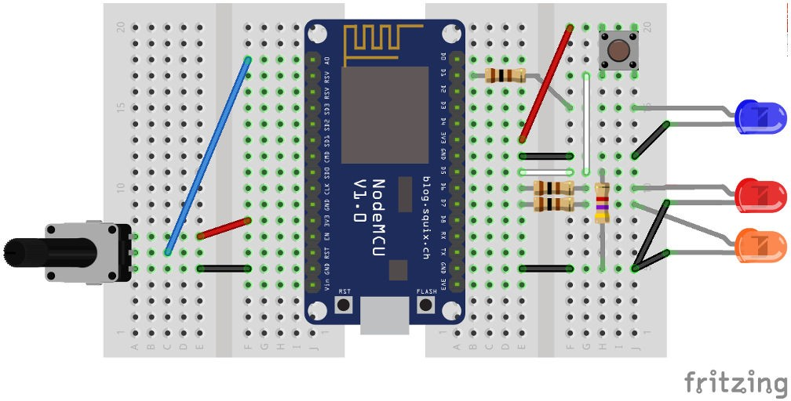
#5 - Prepare the Circuit

Slide 36
#5
Prepare the Circuit
Vibration Motor (brrr): pin 5 (D1) - Blue LED Light Sensor (sunlight): pin A0 - Potentio Red LED (redlight): pin 12 (D6)
Button (pushbutton): pin 14 (D5)
Mini Fan (cooldown): pin 13 (D7) - Orange LED

Slide 37
#include <ESP8266WiFi.h> #include <FirebaseArduino.h>
// Set these to run example.
#define FIREBASE_HOST "fbase-nodemcu.firebaseio.com"
#define FIREBASE_AUTH "g3mvizMBfpXpoSa446BXxPiiBduXFRhZUhgzMjDL" #define WIFI_SSID "lk8fm"
#define WIFI_PASSWORD "1234567890"
const int grovePowerPin = 15; const int vibratorPin = 5; const int lightSensorPin = A0; const int ledPin = 12;
const int buttonPin = 14; const int fanPin = 13;
void setup() {
Serial.begin(115200);
pinMode(grovePowerPin, OUTPUT); digitalWrite(grovePowerPin, HIGH);
FirebaseRoom_ESP8266
pinMode(vibratorPin, OUTPUT); pinMode(lightSensorPin, INPUT); pinMode(ledPin, OUTPUT); pinMode(buttonPin, INPUT); pinMode(fanPin, OUTPUT);
// connect to wifi. WiFi.begin(WIFI_SSID, WIFI_PASSWORD);
Serial.print("connecting");
while (WiFi.status() != WL_CONNECTED) { Serial.print(".");
delay(500);
}
Serial.println(); Serial.print("connected: "); Serial.println(WiFi.localIP());
Firebase.begin(FIREBASE_HOST, FIREBASE_AUTH); Firebase.set("pushbutton", 0);
Firebase.set("sunlight", 0);
Firebase.set("redlight", 0);
37 / 43

Slide 38
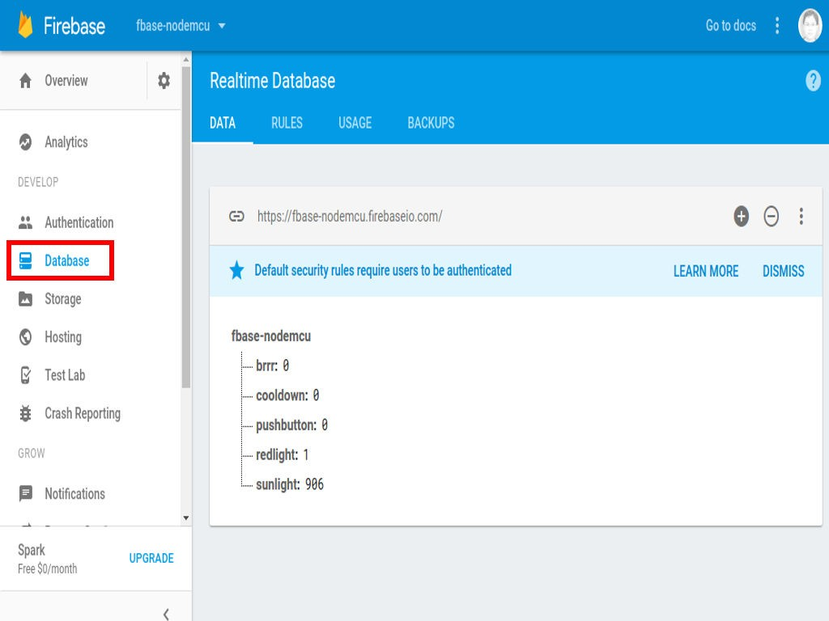
#6 - Changing the Values from Firebase

Slide 39
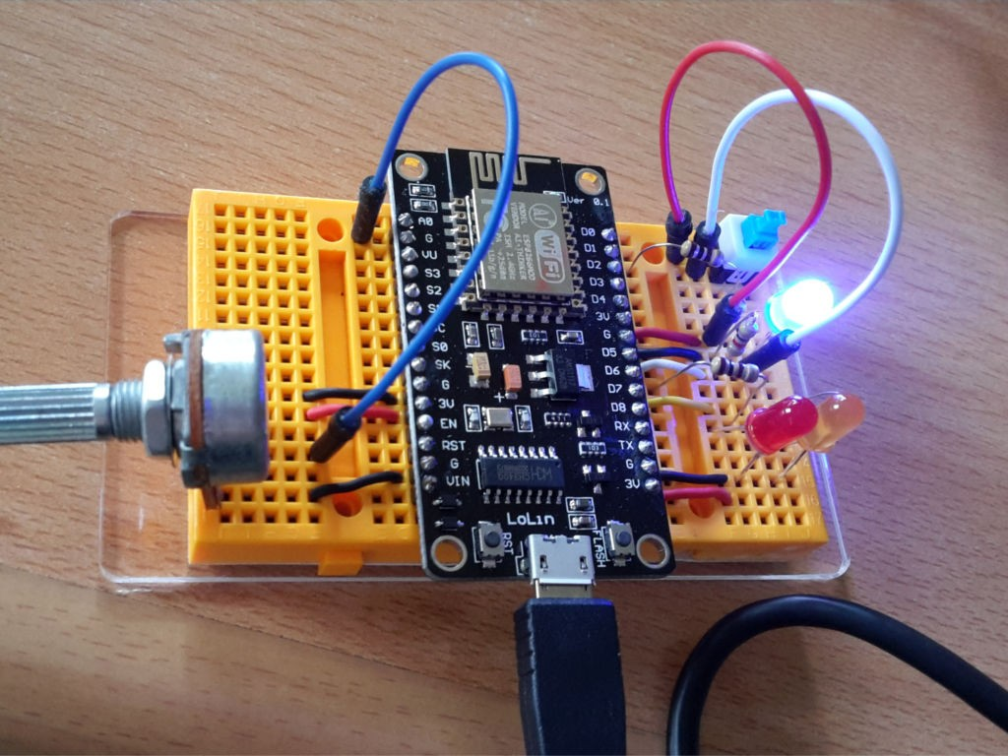
#6 - Changing the States from the Circuit

Slide 40
Refs/Resources

Slide 41
Refs/Resources
NodeMcu - An open-source firmware based on ESP8266 wifi-soc
nodemcu/nodemcu-devkit-v1.0
NodeMCU Documentation
esp8266/Arduino: ESP8266 core for Arduino
Getting Started - Blynk
Simple Led Control With Blynk and NodeMCU Esp8266 12E
FirebaseDemo_ESP8266 - firebase/firebase-arduino
NodeMCU is both a Breadboard-Friendly ESP8266 Wi-Fi Board and a LUA based Firmware
NodeMCU - Wikipedia

Slide 42
More Refs/Resources
nodemcu/nodemcu-firmware: lua based interactive firmware for mcu like esp8266 NodeMCU custom builds
marcelstoer/nodemcu-build - Docker Hub
Comparison of ESP8266 NodeMCU development boards Comparison of tools and IDEs for NodeMCU

Slide 43
END
Eueung Mulyana https://eueung.github.io/012017/nodemcu
CodeLabs | Attribution-ShareAlike CC BY-SA
43 / 43

